Slide 1
Tool support
  Reasons For Enterprise Achitecture Tooling
  Classification.
  The current Achitecture Tool Landscape
  Tool infrastructure.
  Software Achitecture.
  View designer tool.
  Step designer view.

Slide 2
1.Reasons For Enterprise Achitecture Tooling
  Tools help to standardise the semantics and notation of architecture models.
  Tools can support the design of correct and consistent models through automated constraint checking and application of architecture principles.
  Tools can support the architect in the application of architecture patterns and reuse of components and solutions already in use in the organisation.

Slide 3
2.Classification
  Modelling and design: Tools that support modelling and design of architecture models.
  Reporting and publication: Tools that allow the design, either interactively or through configuration, of reports and viewpoints for specific stakeholders.
  Storage and retrieval: Metadata repositories that store meta-models, models, and viewpoint specifications.

Slide 4
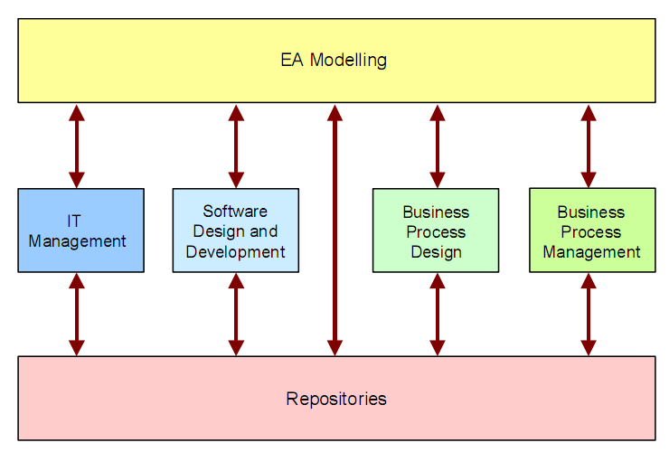
3.The current Achitecture Tool Landscape

Slide 5
3.The current Achitecture Tool Landscape
  Enterprise architecture modelling tools: Tools for enterprise architecture support the complete range of architecture domains, in most cases at a higher abstraction level than domain-specific tools.
  IT management tools: These tools are geared towards managing the IT assets of the enterprise, sometimes called portfolio management tools.
  Software design and development tools: These are software modelling tools that extend their scope to business process modelling and enterprise architecture modelling by adding concepts and diagram types.

Slide 6
3.The current Achitecture Tool Landscape
  Business process design tools: Similar to the software modelling tools,business process modelling tools extend their scope with IT-related concepts and higher-level concepts for enterprise architecture modelling.
  Business process management tools: These are aimed at the operational management of business processes, e.g.,by providing process measurements and other management data.
  Repositories: Metadata repositories and IT management tools that add modelling and analysis capabilities that partly cover the functionality expected from enterprise architecture modelling tools.

Slide 7
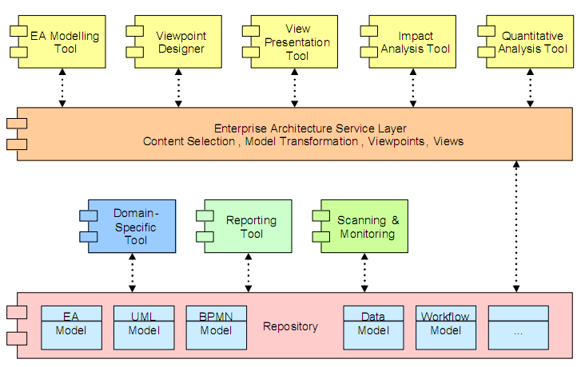
4.Tool infrastructure
Even though an architecture captures the relatively stable parts of busi-
ness and technology, any architecture will need to accommodate change,
and architecture products will therefore only have a temporary status

Slide 8
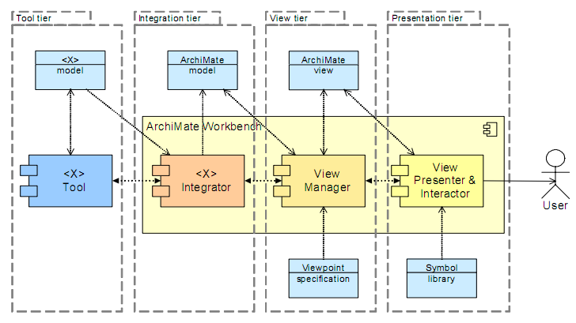
5.Software Achitecture

Slide 9
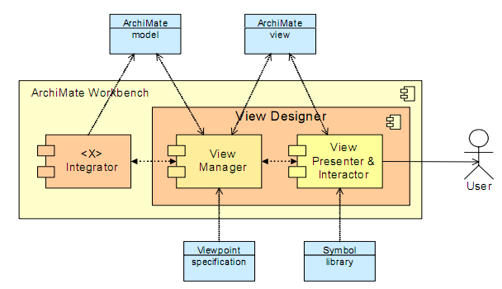
6.View designer tool

Slide 10
7.Steps designed view
  Define the static part of the viewpoint using viewpoint rules for the model and viewpoint rules for its visualisation.
  For every model and view, define the actions that can change the model or view.
  For every action, define which parameters it needs to have to be executed.
  Define how these parameters can be collected.
  Define the order of steps (protocol), including the use of virtual input devices (menus, text input, buttons, etc.), variables, and constants.

